Slide 1


Salary Prediction for Data Professionals
Using Machine Learning Models

Slide 2


Introduction
Problem Statement: Salaries in the field of data professions vary widely due to factors such as experience, job role, and performance. Accurately predicting these salaries is crucial for job seekers to understand their market value and for employers to offer competitive compensation. The goal is to develop a predictive model that uses these factors to estimate salaries, providing valuable insights for both parties in the job market. This model will aid in making informed decisions regarding career planning and hiring strategies.
 | 4
 | 5
 | 6
 | 7

Slide 3
Why Is This Project Important?
For Job Seekers: Market Value Understanding: Helps job seekers understand their market value. Career Planning: Enables effective career planning based on potential earnings. Fair Compensation: Ensures fair compensation compared to industry standards. For Employers: Competitive Compensation Packages: Allows offering competitive compensation packages. Budget Planning: Aids in accurate budget planning and resource allocation. Benchmarking: Helps benchmark salary offerings against industry standards.
 | 4
 | 5
 | 6
 | 7

Slide 4
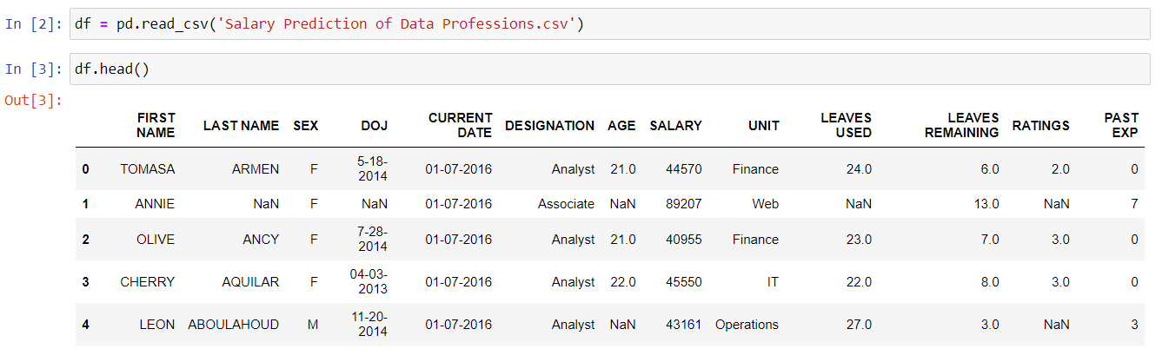
Dataset Overview
The dataset contains the following columns:
➢ `FIRST NAME`: First name
➢ `LAST NAME`: Last name
➢ `SEX`: Gender
➢ `DOJ`: Date of joining the company
➢ `CURRENT DATE`: Current date of data
➢ `DESIGNATION`: Job role/designation
➢ `AGE`: Age
➢ `SALARY`: Target variable,
➢ `UNIT`: Business unit or department
➢ `LEAVES USED`: Number of leaves used
➢ `LEAVES REMAINING`: Number of leaves remaining
➢ `RATINGS`: Ratings or performance ratings
➢ `PAST EXP`: Past work experience

Slide 5
Exploratory Data Analysis (EDA)
data.info():
Provides a summary of the dataset, including the number of entries, columns, data types, and non-null counts.
1. Data Understanding and Cleaning: EDA helps to understand the data structure, identify missing values, and detect outliers.
2. Pattern Discovery: It reveals patterns and relationships between variables, such as the impact of experience or job role on salary.
3. Feature Selection and Transformation: EDA aids in selecting relevant features and transforming data to enhance model accuracy and performance.
data.describe():
Generates descriptive statistics for numerical columns, including count, mean, standard deviation, min, and max values.

Slide 6

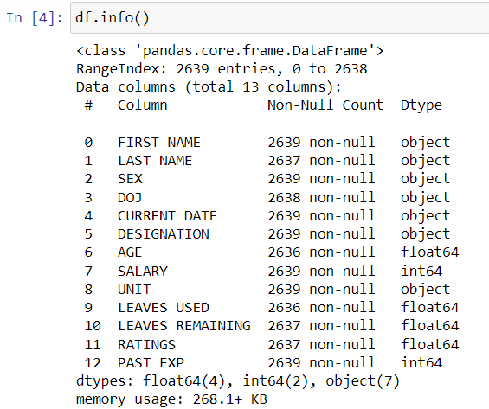
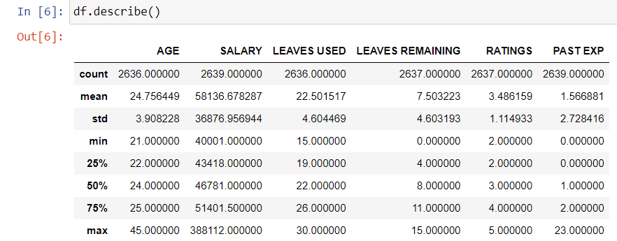
data.info()
data.describe()

Slide 7
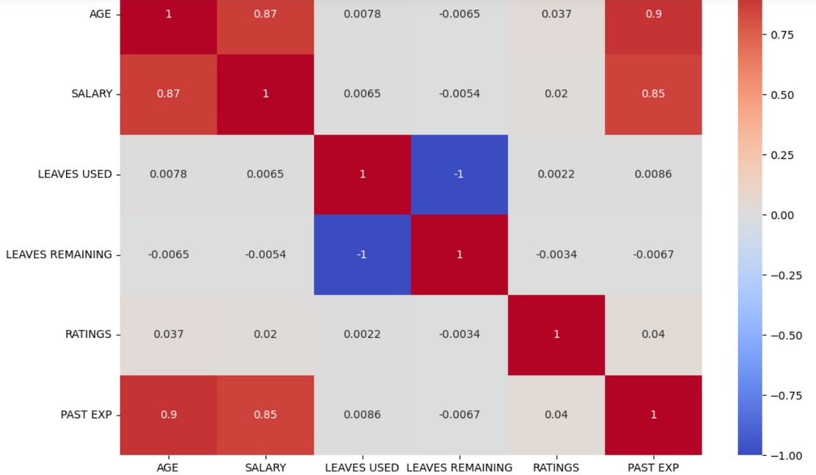
Correlation Heatmap
There are strong positive correlations between AGE and SALARY (0.87), AGE and PAST EXP (0.9), and SALARY and PAST EXP (0.85), indicating that as age increases, both salary and past experience tend to increase significantly. Conversely, there is a perfect negative correlation between LEAVES USED and LEAVES REMAINING (-1), meaning that more leaves used result in fewer leaves remaining, as expected. The other variables exhibit very weak or negligible correlations, suggesting no significant linear relationships among them. Overall, age, salary, and past experience are closely interlinked, while the number of leaves used and remaining are inversely related..

Slide 8
Feature Engineering
The code first converts `CURRENT DATE` and `DOJ` columns to datetime format. It then calculates total experience by adding past experience (`PAST EXP`) to the tenure at the current company, and stores this in a new `EXPERIENCE` column. Finally, it categorizes `RATINGS` into bins labeled 1 to 5, creating the `RATINGS_CAT` feature.
CODE:
df['CURRENT DATE'] = pd.to_datetime(df['CURRENT DATE'])
df['DOJ'] = pd.to_datetime(df['DOJ'])
df['EXPERIENCE'] = df['PAST EXP'] + (df['CURRENT DATE'] - df['DOJ']).dt.days / 365
df['RATINGS_CAT'] = pd.cut(df['RATINGS'], bins=[0, 2, 4, 6, 8, 10], labels=[1, 2, 3, 4, 5]) .

Slide 9
The new feature `YEARS_WITH_COMPANY` is calculated by determining the duration between the `CURRENT DATE` and the `DOJ` (Date of Joining), converted into years. This feature represents the number of years a professional has been with their current company. Its significance in the prediction model lies in its ability to capture the impact of tenure on salary, as longer tenure often correlates with higher salaries due to accumulated experience, loyalty, and potential promotions.
Data Preprocessing
Back togenda
X['CURRENT DATE'] = (X['CURRENT DATE'] - pd.to_datetime('1970-01-01')).dt.days
X['DOJ'] = (X['DOJ'] - pd.to_datetime('1970-01-01')).dt.days

Slide 10







Linear Regression:
A simple model that predicts salaries by fitting a linear relationship between the features and the target variable, chosen for its interpretability.
Models Used
Random Forest:
An ensemble model that uses multiple decision trees to improve prediction accuracy and robustness, chosen for its ability to handle complex relationships and non-linear data.
Gradient Boosting:
An advanced ensemble technique that builds models sequentially to correct errors of previous models, chosen for its high predictive power and ability to handle various types of data.

Slide 11
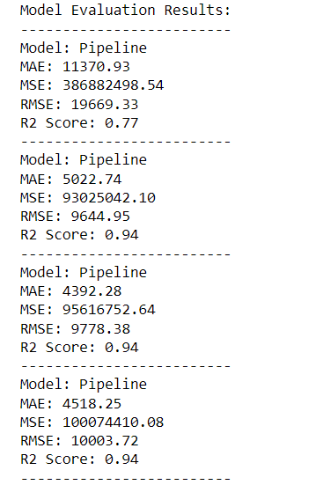
Model Evaluation
Evaluation Metrics:
Mean Absolute Error (MAE): Measures the average magnitude of errors in the predictions, without considering their direction. In this case, MAE is 11,370.93, indicating the average error in salary prediction.
Mean Squared Error (MSE): Measures the average of the squared differences between predicted and actual values, penalizing larger errors more. Here, MSE is 386,882,498.54.
Root Mean Squared Error (RMSE): The square root of MSE, providing error magnitude in the same units as the target variable. An RMSE of 19,669.33 means the typical prediction error is around 19,669.
R2 Score (R2): Indicates the proportion of variance in the dependent variable predictable from the independent variables. An R2 score of 0.77 means 77% of the variance in salary can be explained by the model.
Linear Regression
Decision Tree Regressor
Random Forest Regressorr
Gradient Boosting Regressor

Slide 12
Reason of Choosing Linear Regression as the Model
The Linear Regression model shows a reasonable performance with an R2 score of 0.77, suggesting it explains 77% of the variance in salaries. The errors (MAE, MSE, and RMSE) indicate some prediction inaccuracies, but the model is still effective for a linear approach. Linear Regression was chosen for its simplicity and interpretability, making it a good baseline model to understand the relationship between features and salary before exploring more complex models.
results = []
for model in models:
model.fit(X_train_scaled, y_train)
y_pred = model.predict(X_test_scaled)
mae = mean_absolute_error(y_test, y_pred)
mse = mean_squared_error(y_test, y_pred)
rmse = np.sqrt(mse)
r2 = r2_score(y_test, y_pred)
results.append((model.__class__.__name__, mae, mse, rmse, r2))

Slide 13
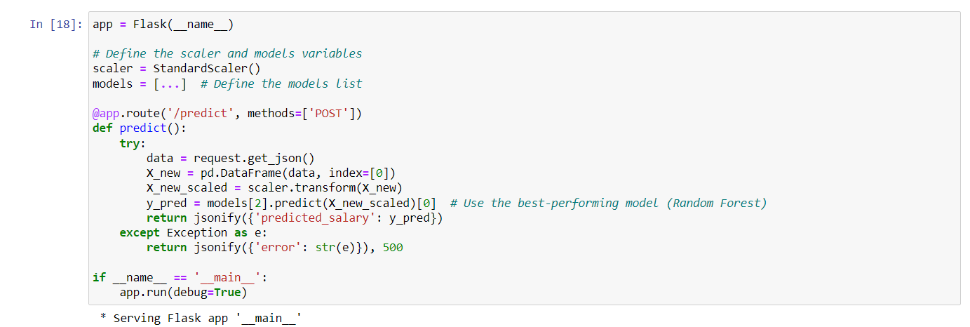
Model Deployment
The deployment process involves creating a Flask web application, which serves as an interface for the trained model. Users can send input data to the Flask API, which processes the data and returns salary predictions.
Deploying the model enables real-world usage, allowing users to easily access and benefit from salary predictions through a simple web interface. This makes the model practical and accessible for decision-making in hiring and job seeking.

Slide 14
Conclusion
Potential Improvements and Future Work
Future work could involve incorporating more advanced models like deep learning to improve prediction accuracy. Enhancing feature engineering by adding more relevant features, such as education level or industry-specific factors, could also boost performance. Additionally, continuous model retraining with new data will ensure the model remains accurate and up-to-date. Lastly, deploying the model on a cloud platform for scalability and integrating it with user-friendly interfaces can enhance accessibility and usability.

Slide 15
THANK
YOU
BY-
SHREENITA SAHA

